Slide 1
Topic for Today
Lambda Functions
Functional Programming Tools for List
List Comprehension
Modules and Packages
File Input/Output
Introduction to Classes

Slide 2
Lambda Function
anonymous functions can be created with lambda keyword
functions that are not bound to a name
syntactically restricted to a single expression
always contains an expression which is returned but does not include a return statement

Slide 3
Lambda Function
Syntax lambda argument(s): expression
Example y = lambda x: x ** 2 y(5) #computes the square of 5 sum = lambda a, b: a + b sum(1,2) #computes the sum of 1 and 2

Slide 4
Functional Programming Tools
lambda expressions are particularly useful to functional programming
python supports functional programming where you can pass functions to other functions to do stuff
three built-in functions that are very useful when used with list: filter(), map(), reduce()

Slide 5
Filter
filter(function, sequence)
offers an elegant way to filter out all the elements of a list, for which the function returns True
function returns a Boolean value, i.e. either True or False. This function will be applied to every element of the sequence. Only if function returns True will the element of the sequence be included in the result list

Slide 6
Filter
>>> alist= [0,1,1,2,3,5,8,13,21,34,55]
>>> result = filter(lambda x: x % 2, alist)
>>> print result
[1, 1, 3, 5, 13, 21, 55]
>>> result = filter(lambda x: x % 2 == 0, alist) >>> print result
[0, 2, 8, 34]
>>>

Slide 7
Map
map(function, sequence)
calls function(item) for each of the sequence’s item and returns a list of the return values
>>> map(lambda x: x*x*x, range(1,6))
[1, 8, 27, 64, 125]
>>> a = [1,2,3,4] >>> b = [17,12,11,10]
>>> map(lambda x, y: x + y, a, b)
[18, 14, 14, 14]

Slide 8
Reduce
reduce(function, sequence [, start_value])
continually applies the function to the sequence. It returns a single value
a third argument can be passed to indicate the starting value. In this case, the starting value is returned for an empty sequence >>> reduce(lambda x,y: x+y, [47,11,42,13]) 113 >>> reduce(lambda x: x**2, [], 1) 1

Slide 9
List Comprehension
provides a concise way to create lists
consists of brackets containing an expression followed by a for clause, the zero or more for and if clauses it follows >>> squares = [x**2 for x in range(5)] [0, 1, 4, 9, 16] >>> [(x,y) for x in [1,2] for y in [1,3] if x = y] [(1,1)]

Slide 10
String
str = 'Hello World!'
print(str) # Prints complete string
print(str[0]) # Prints first character of the string
print(str[2:5]) # Prints characters 3rd – 5th
print(str[2:]) # Prints string starting from 3rd
print(str * 2) # Prints string two times
print(str + "TEST”) # Prints concatenated string
print(str[-1])?

Slide 11
Built in Methods
len()
str.capitalize()
str.count(substr, start = 0, end = len(string))
str.find(substr, start, end) or str.rfind(substr, start, end)
str.lower() or str.upper()
str.replace(old, new, max)
str.split()

Slide 12
Built in Methods
str.strip(chars)
str.lstrip(chars) or str.rstrip(chars)
str.startswith(substr, start, end) or str.endswith(substr, start,end)
str.isdigit()
str.islower() or str.isupper()
str.translate(table, delete_chars)
reversed(str)

Slide 13
Dictionary
kind of hash table type key-value pair.
key can be any data type
usually numbers and strings

Slide 14
Dictionary
d = {}
d['one'] = "This is one"
d[2] = "This is two"
d2 = {'name': 'john','code':6734, 'dept': 'sales'}
print(d['one']) # Prints value for 'one' key
print(d[2]) # Prints value for 2 key
print(d2) # Prints complete dictionary

Slide 15
Built in Methods
cmp(dictionary1, dictionary 2)
len(d)
str(d)
type(variable)

Slide 16
Built in Functions
d.clear()
d.copy()
d.fromkeys()
d.get(key)
d.has_key(key)
Notes:
clear – remove copy – d1 = d2.copy()
fromkeys – x = dict.fromkeys(list, value) only 1 value

Slide 17
Built in Functions
d.items()
d.keys()
d.values()
d.update(d2)
d.setdefault(key, default=value)
Notes:
update – add d2 to d
setdefault is similar to get with try catch

Slide 18
Modules
is a file containing Python definitions and statements somemodule.py
>>> import somemodule >>> somemodule.somefunction()
>>> from somemodule import somefunction >>> somefunction()
>>> from somemodule import * >>> somefunction()

Slide 19
Modules
the interpreter searches the module in the ff. sequence
the directory containing the input script (or the current directory)
PYTHONPATH (a list of directory names, with the same syntax as the shell variable PATH)
the installation-dependent default.
Standard Module Library: https://docs.python.org/2/library/index.html

Slide 20
dir() function
used to find out which names a module defines
import somemodule dir(somemodule)
[‘__name__’, ‘somefunction’]
without arguments, dir() lists the names you have defined currently
Notes:
Note that it lists all types of names: variables, modules, functions, etc.
dir() does not list the names of built-in functions and variables. If you want a list of those, they are defined in the standard module __builtin__:

Slide 21
reload()
imports a previously imported module again.
from importlib import reload
reload(somemodule)

Slide 22
Packages
way of structuring Python’s module namespace by using “dotted module names”
a hierarchical file directory structure that defines a single Python application environment that consists of modules and subpackages and sub-subpackages, and so on

Slide 23
Packages
sound/ __init__.py formats/ __init__.py wavread.py wavwrite.py aiffread.py ... effects/ __init__.py echo.py surround.py reverse.py ...

Slide 24
Packages
__init__.py from somesubmodule1 import somesubfunction1 from somesubmodule2 import somesubfunction2 from somesubmodule3 import somesubfunction3

Slide 25
FILE I/O
Opening the file
fo = open(file_name, mode)
Reading/Writing from the file
fo.read(# of chars) or fo.readline() fo.write()
Closing the file
fo.close()
Notes:
for line in fo:
print line

Slide 26
FILE I/O
To return an integer giving the file object’s current position in the file, measured in bytes from the beginning of the file. fo.tell()
To change the file object’s position fo.seek(offset, from_what)
from_what – 0 (default) measures from the beginning of the file, 1 uses the current file position, and 2 uses the end of the file as the reference point

Slide 27
FILE I/O - Attributes
fo.closed
fo.name
fo.mode

Slide 28
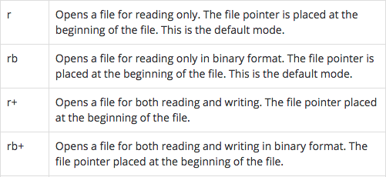
Access Mode

Slide 29
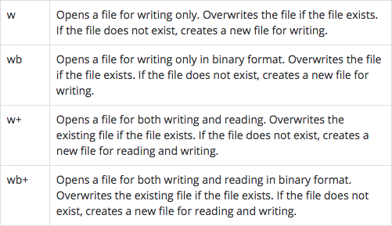
Access Mode

Slide 30
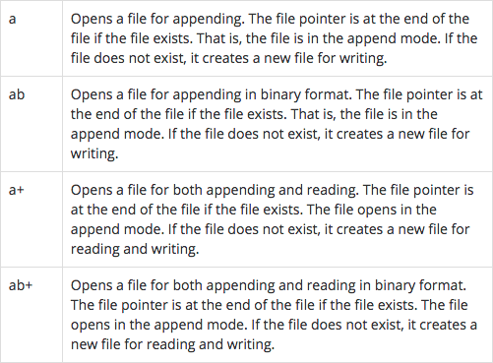
Access Mode

Slide 31
FILE I/O
SCRIPT
from sys import argv
from os.path import exists
script, from_file, to_file = argv
input = open(from_file)
indata = input.read()
if not exists(to_file):
output = open(to_file, ‘w’)
output.write(indata)
output.close()
input.close()

Slide 32
FILE I/O
SCRIPT
from sys import argv
from os.path import exists
script, from_file, to_file = argv
with open(from_file, 'r') as f:
indata = f.read()
with open(to_file, 'w') as g:
g.write(indata)
f.close()
g.close()

Slide 33
Regular Expression
term "regular expression", sometimes also called regex or regexp, is originated from theoretical computer science
used to define a language family with certain characteristics, the so-called regular languages
used in programming languages to filter texts or textstrings
syntax of regular expressions is the same for all programming and script languages, e.g. Python, Perl, Java, SED, AWK

Slide 34
Regular Expression
if you want to use regular expressions in Python, you have to import the re module, which provides methods and functions to deal with regular expressions
Regular expressions are represented as raw strings
backslash is a special character used in regular expressions, but is also used as an escape character in strings
to overcome this problem, regular expressions are marked as raw strings r"^a.*\.html$"

Slide 35
Search
re.search(regex, string)checks a string for an occurrence of a substring which matches the regular expression regex >>> import re >>> x = re.search("cat","A cat and a rat can't be friends.") >>> print x <_sre.SRE_Match object at 0x7fd4bf238238> >>> x = re.search("cow","A cat and a rat can't be friends.") >>> print(x) None

Slide 36
Regular Expression
. (dot symbol) is for any character r" .at ” #matches any 3 letter word that ends with at
[ ] (square brackets) are used to include a character class [xyz] means either an x, a y or a z
- (dash symbol) to denote range [a-e] means [abcde] [0-5] means [012345]

Slide 37
Regular Expression
^ (caret symbol) used directly after the opening square bracket to denote negation [^abc] means anything but an "a", "b" or "c”
^ (caret symbol) is also used to match the start of the string r”^The” means the string starts with a The
$ (dollarsymbol) matches the end of a string

Slide 38
Regular Expression
? (question mark) declares that the preceding character or expression is optional r"M[ae][iy]e?r" means e is optional
subexpression is grouped by round brackets and a question mark following such a group means that this group may or may not exist r"Feb(ruary)? 2011"

Slide 39
Regular Expression
* (asterisk symbol) following a character or a subexpression means that this expression or character may be repeated arbitrarily, even zero times
+ (plus symbol) is very similar to the star operator, except that the character or subexpression followed by a "+" sign has to be repeated at least one time
{from, to}: this means that the expression has to appear at least "from" times and not more than "to" times. {, to} is an abbreviated spelling for {0,to} and {from,} is an abbreviation for "at least from times but no upper limit"

Slide 40
Regular Expression
\d | Matches any decimal digit; equivalent to the set [0-9].
\D | The complement of \d. It matches any non-digit character; equivalent to the set [^0-9].
\s | Matches any whitespace character; equivalent to [ \t\n\r\f\v].
\S | The complement of \s. It matches any non-whitespace character; equiv. to [^ \t\n\r\f\v].
\w | Matches any alphanumeric character; equivalent to [a-zA-Z0-9_]. With LOCALE, it will match the set [a-zA-Z0-9_] plus characters defined as letters for the current locale.
\W | Matches the complement of \w.
\b | Matches the empty string, but only at the start or end of a word.
\B | Matches the empty string, but not at the start or end of a word.
\\ | Matches a literal backslash.

Slide 41
Regular Expression
re.findall(pattern, string[, flags])
re.sub(regex, replacement, string)

Slide 42
Classes
Class: A user-defined prototype for an object that defines a set of attributes that characterize any object of the class. The attributes are data members (class variables and instance variables) and methods, accessed via dot notation.
Class variable: A variable that is shared by all instances of a class. Class variables are defined within a class but outside any of the class's methods. Class variables aren't used as frequently as instance variables are
Data member: A class variable or instance variable that holds data associated with a class and its objects.

Slide 43
Classes
Instance variable: A variable that is defined inside a method and belongs only to the current instance of a class.
Instance: An individual object of a certain class. An object obj that belongs to a class Circle, for example, is an instance of the class Circle.
Instantiation : The creation of an instance of a class.
Object : A unique instance of a data structure that's defined by its class. An object comprises both data members (class variables and instance variables) and methods

Slide 44
Classes
class Employee:
'Common base class for all employees'
empCount = 0
def __init__(self, name, salary):
self.name = name
self.salary = salary
Employee.empCount += 1
def displayCount(self):
print("Total Employee %d" % Employee.empCount)
def displayEmployee(self):
print("Name : ", self.name, ", Salary: ", self.salary)

Slide 45
Classes
emp1 = Employee("Zara", 2000)
emp2 = Employee("Manni", 5000)
emp1.displayEmployee()
emp2.displayEmployee()
print("Total Employee %d" % Employee.empCount)
Notes:
The getattr(obj, name[, default]) : to access the attribute of object.
The hasattr(obj,name) : to check if an attribute exists or not.
The setattr(obj,name,value) : to set an attribute. If attribute does not exist, then it would be created.
The delattr(obj, name) : to delete an attribute.

Slide 46
Inheritance
Inheritance : The transfer of the characteristics of a class to other classes that are derived from it.
Private Class Variable
obj._className.__private
Notes:
__dict__ : Dictionary containing the class's namespace.
__doc__ : Class documentation string or None if undefined.
__name__: Class name.
__module__: Module name in which the class is defined. This attribute is "__main__" in interactive mode.
__bases__ : A possibly empty tuple containing the base classes, in the order of their occurrence in the base
class list.

Slide 47
Exercises
Identify if a given string is a pangram. A pangram is a sentence, phrase or verse that contains all the letters of the alphabet.
Given the following mapping:
key = {'a':'n', 'b':'o', 'c':'p', 'd':'q', 'e':'r', 'f':'s', 'g':'t', 'h':'u', 'i':'v', 'j':'w','k':'x', 'l':'y', 'm':'z', 'n':'a', 'o':'b', 'p':'c', 'q':'d', 'r':'e', 's':'f', 't':'g', 'u':'h','v':'i', 'w':'j', 'x':'k','y':'l', 'z':'m', 'A':'N', 'B':'O', 'C':'P', 'D':'Q', 'E':'R', 'F':'S','G':'T', 'H':'U', 'I':'V', 'J':'W', 'K':'X', 'L':'Y', 'M':'Z', 'N':'A', 'O':'B', 'P':'C', 'Q':'D','R':'E', 'S':'F', 'T':'G', 'U':'H', 'V':'I', 'W':'J', 'X':'K', 'Y':'L', 'Z':'M'}
Decode any given string. Hint: you have to import the library string to use the methods join, translate and maketrans.

Slide 48
Exercises
The International Civil Aviation Organization (ICAO) alphabet assigns code words to the letters of the English alphabet acrophonically so that critical combinations of letters can be pronounced and understood by those who transmit and receive voice messages by radio or telephone regardless of their native language, especially when the safety of navigation or person is essential.
d = {'a':'alfa', 'b':'bravo', 'c':'charlie', 'd':'delta', 'e':'echo', 'f':'foxtrot', 'g':'golf', 'h':'hotel', 'i':'india', 'j':'juliett', 'k':'kilo', 'l':'lima', 'm':'mike', 'n':'november', 'o':'oscar', 'p':'papa', 'q':'quebec', 'r':'romeo', 's':'sierra', 't':'tango', 'u':'uniform', 'v':'victor', 'w':'whiskey', 'x':'x-ray', 'y':'yankee', 'z':'zulu'}
Write a procedure speak_ICAO() that translates any text into spoken ICAO words. Import two libraries: os and time. You have access to the system TTS (text-to-speech) by os.system(‘say ‘ + msg) where msg is the string to be spoken. Aside from the string parameter, accept two floats that will indicate the length of pause between ICAO words (the letters) and between each word spoken.

Slide 49
Exercises
From a string input, create a per-word letter-counter that excludes the article the from the count. Use a shorthand looping in lists.
The aliens invaded the Earth. Their language goes like this: if the letter is a consonant, they spell it as consonant + o + consonant (as in, h = hoh). Vowels are spelled as is. Translate a given list of strings to this alien language using the method map().
Given an input text file, create a new file that numbers the input text file per line. Use the argv module from the sys package so that your run command is something like: python exercise6.py input.txt output.txt

Slide 50
Exercises
From an input text file, get the average count of all the letters in that file.
From a file simpsons_phone_book.txt, print all lines that matches these characteristics: starts with J, followed by any letter, and surname is Neu. Some input may be improperly spaced so it should follow that names with several spaces between the first name and last name is accepted.

Slide 51
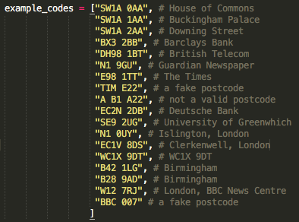
Exercises
Below is a list of sample postcodes:
A valid postcode is defined by these characteristics:
has 2 codes separated by space
first code:
starts in 1 or 2 capital letters
followed by number or the letter R
optional: end with any number or capital letter
second code:
any number
exactly 2 capital letters except C I K M O V Your task is to identify correctly the valid and invalid postcodes in the given list example_codes.

Slide 52
Exercises
Create a class Circle with methods __init__(self, r) where r is the radius of the circle, and area(self) which is the area of the circle. Make sure you also create an attribute radius, which is equal to the value of r. The user will input the desired radius, and your program should compute the area.
Do exercise 10 but using class Rectangle.
Create a class Song that has methods: __init__(self, lyrics) where lyrics is a list containing the lines of the input song, and sing_me_a_song that prints all the lines of the song.

